Slide 1
Stroke Risk Stratification: Identifying Vulnerable Individuals Through Data Visualization
Joshua Okojie
Lindsay Hudson
Mariluz Lopez Zamora

Slide 2
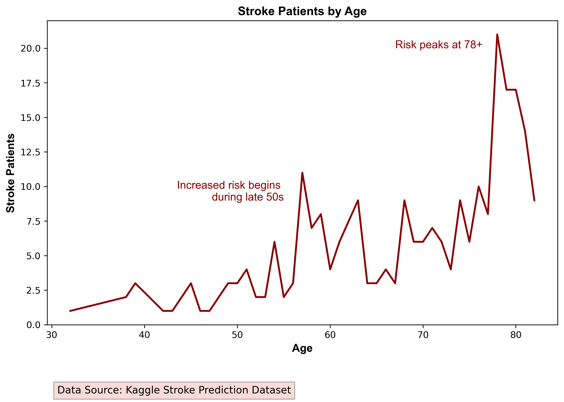
Objectives:
Analyze and visualize the stroke prediction dataset.
Develop a target model identifying individuals most at risk of suffering a stroke.
Support: preventive measures and public health campaigns.
Notes:
Lindsay

Slide 3
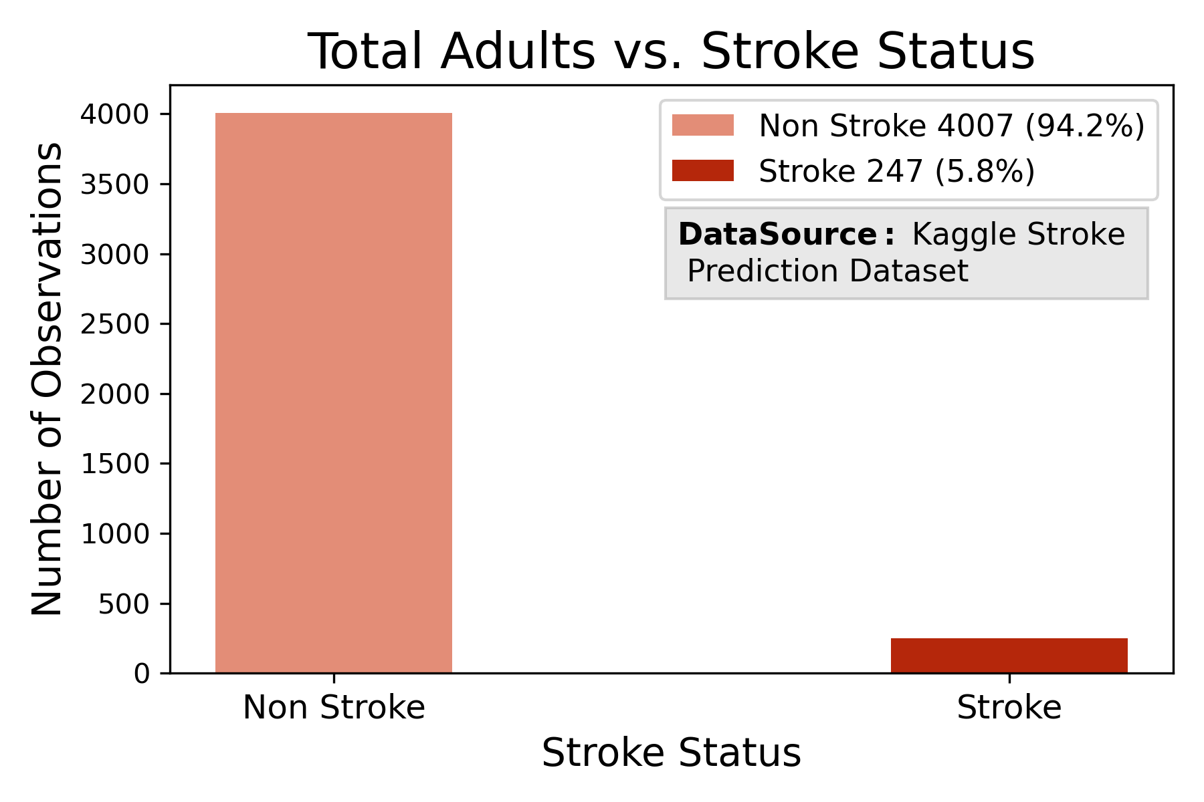
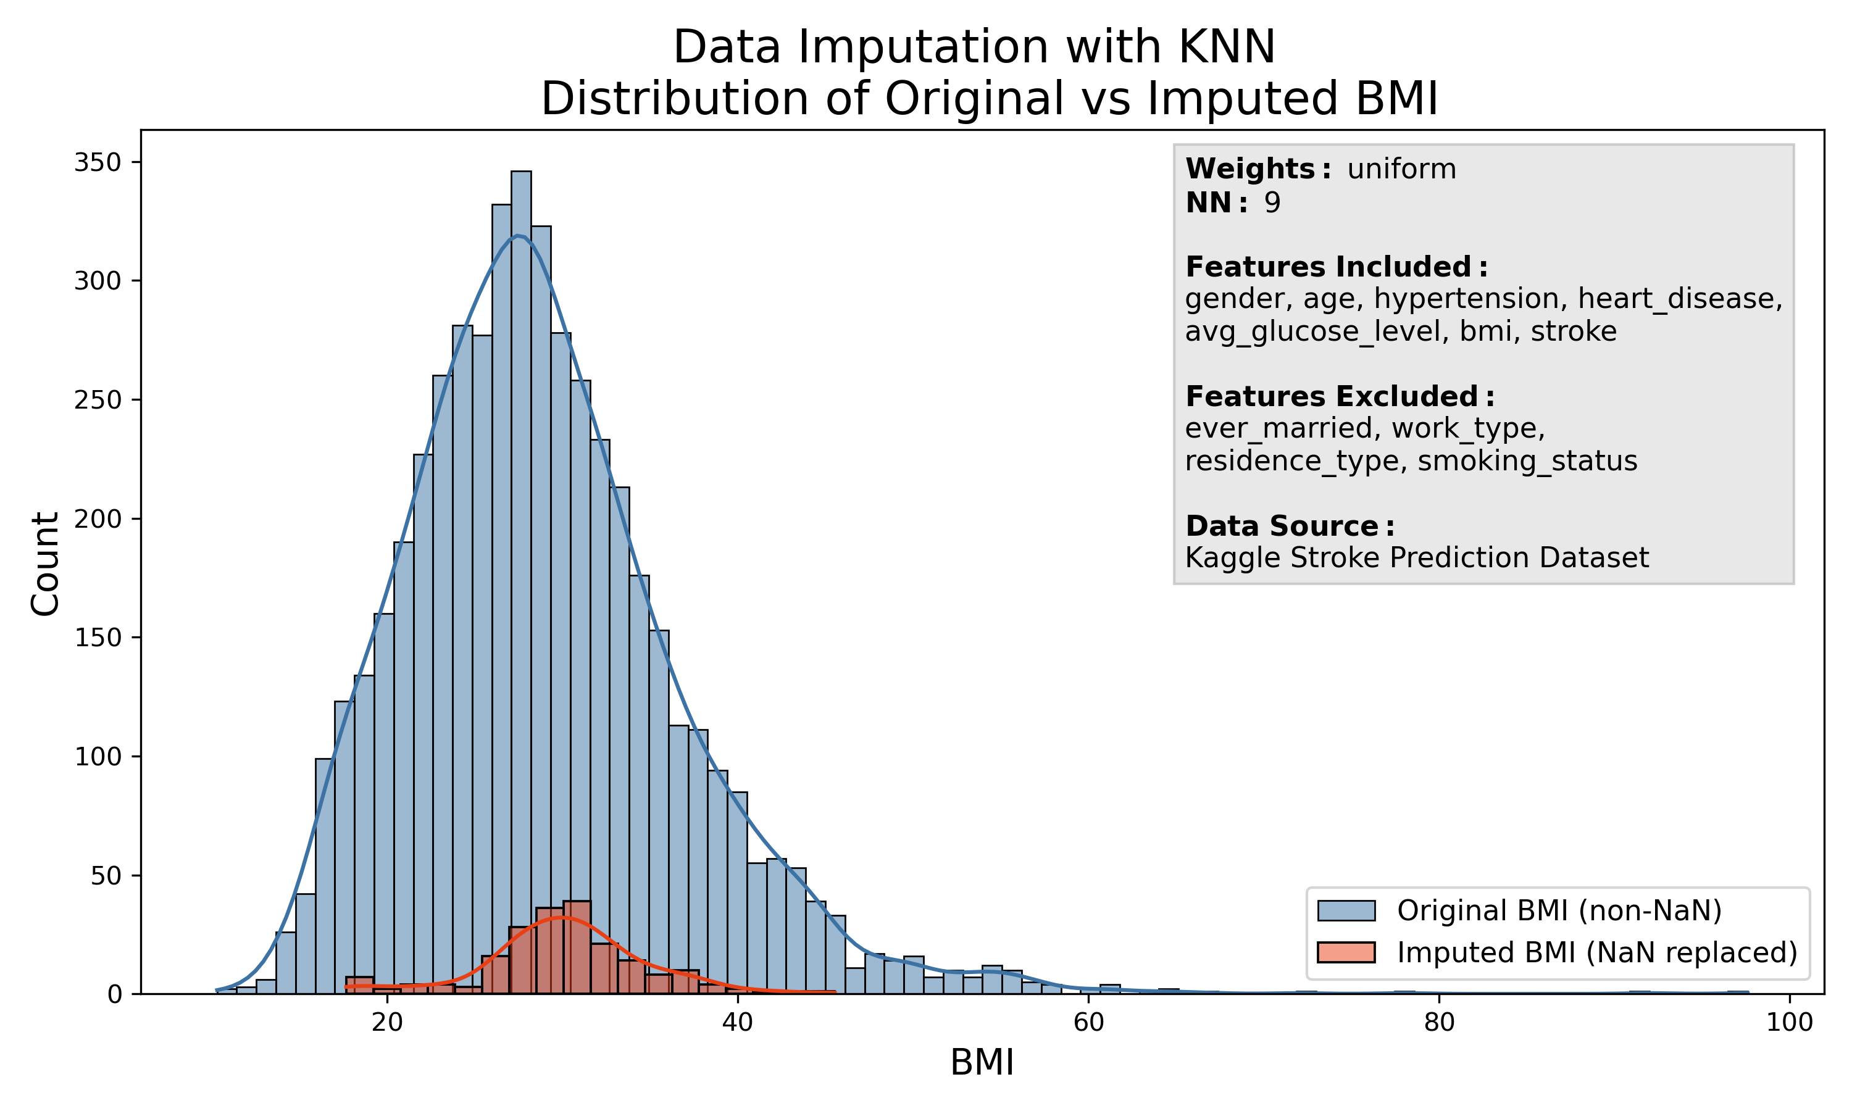
Problems with the Data:
Imbalance
Confounding factors: pediatric population
Lack of context related with data collection method
Variability: Age, BMI, and Average Glucose Levels
  ADA Classification
  CDC BMI Classification
  Canadian Age Classification
Missing Data:
  BMI: NaN values
  Smoking status: Unknown
Notes:
Mariluz: Imbalance, Confunding factors
Slide 3.
Imbalance: 5,110 observations
856 individuals under 18 years old
249 stroke cases (only 2 pediatric)
4,007 non-stroke cases
Confounding factors:
As our goal was to support stroke prevention, we need considered the important differences between adults and pediatric population.
Because the causes of stroke in children are mostly related to genetic factors and non-preventable conditions—and because the incidence is very low—the pediatric population was removed from the analysis and the model. This helped reduce confounding factors associated with their differences compared to adults AND INCREASED THE ACCURACY OF THE MODEL.
Linday: Lack of context, missing data, variability

Slide 4
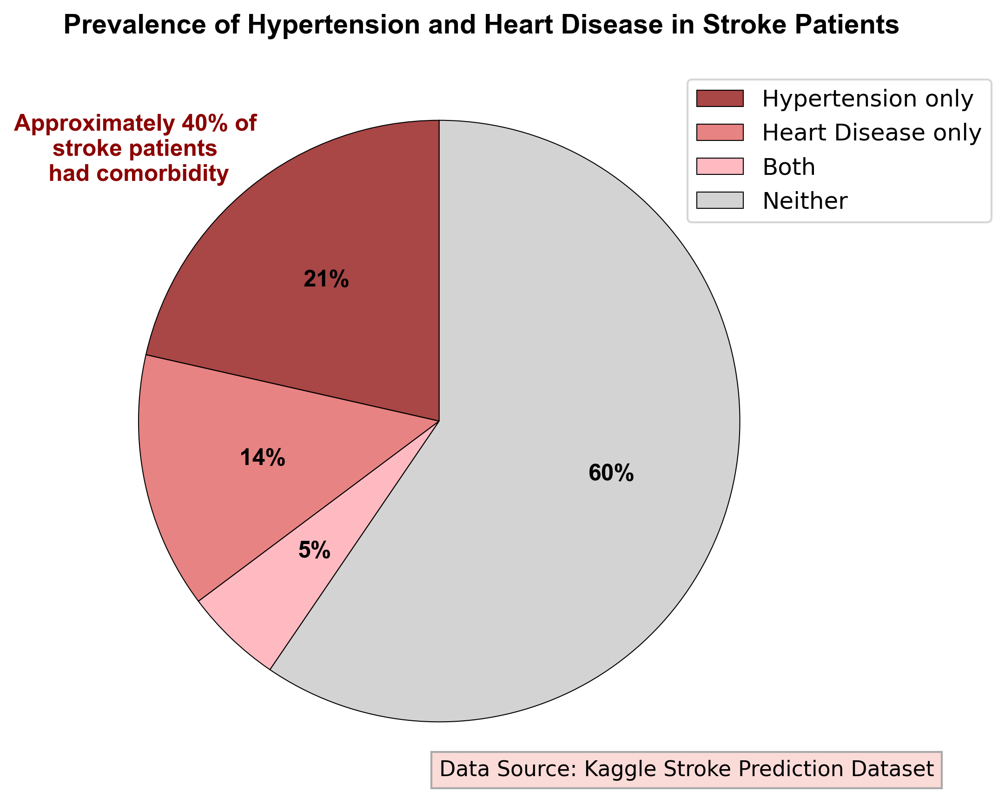
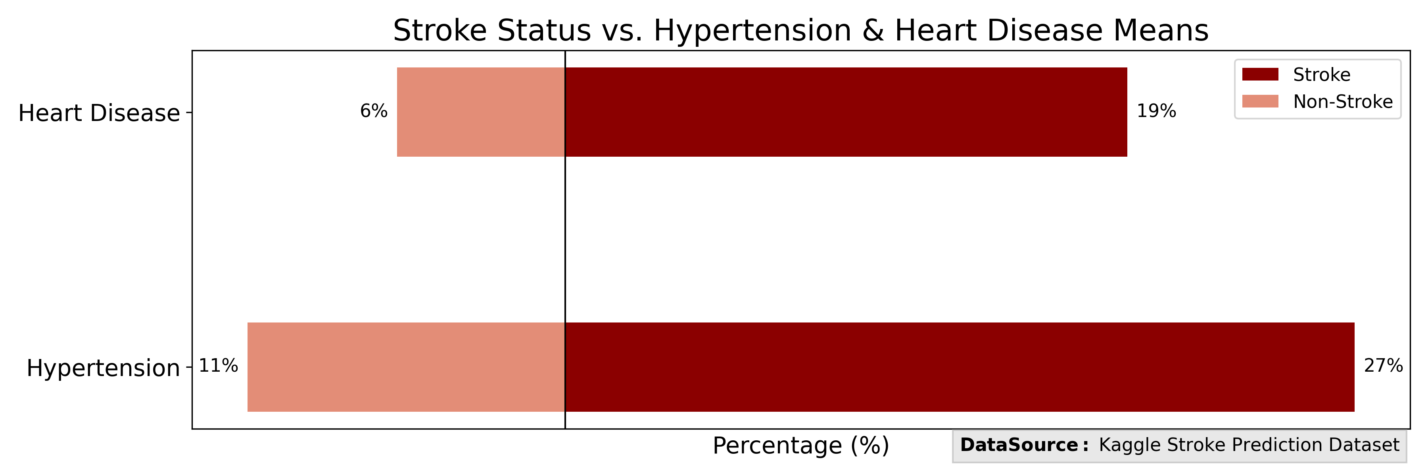
Feature Selection:
Excluded Features (Not significant, p-value > 0.5):
  Gender
  Marital Status (adjusted for age)
  Residence Type
Included Features (Significant, p-value < 0.5):
  Age
  Work Type
  Smoking Status
  Glucose Level
  BMI
  Hypertension
  Heart Disease
Notes:
Mariluz
Slide 4.
After a statistical analysis comparing the stroke group with the non-stroke group:
We removed gender and residence type due to non-significant differences.
Initially, the analysis showed that ever merred was correlated with stroke, but after adjusting for age, this difference was no longer significant.
We included only the features that showed statistically significant differences to improve the accuracy of the predictive model:
Invariable demographic factors: Age
Potentially variable demographic factors: Work Type
Variable risk factors: Glucose level, BMI, Smoking status
Invariable risk factors (comorbidities): Hypertension and Heart Disease

Slide 5
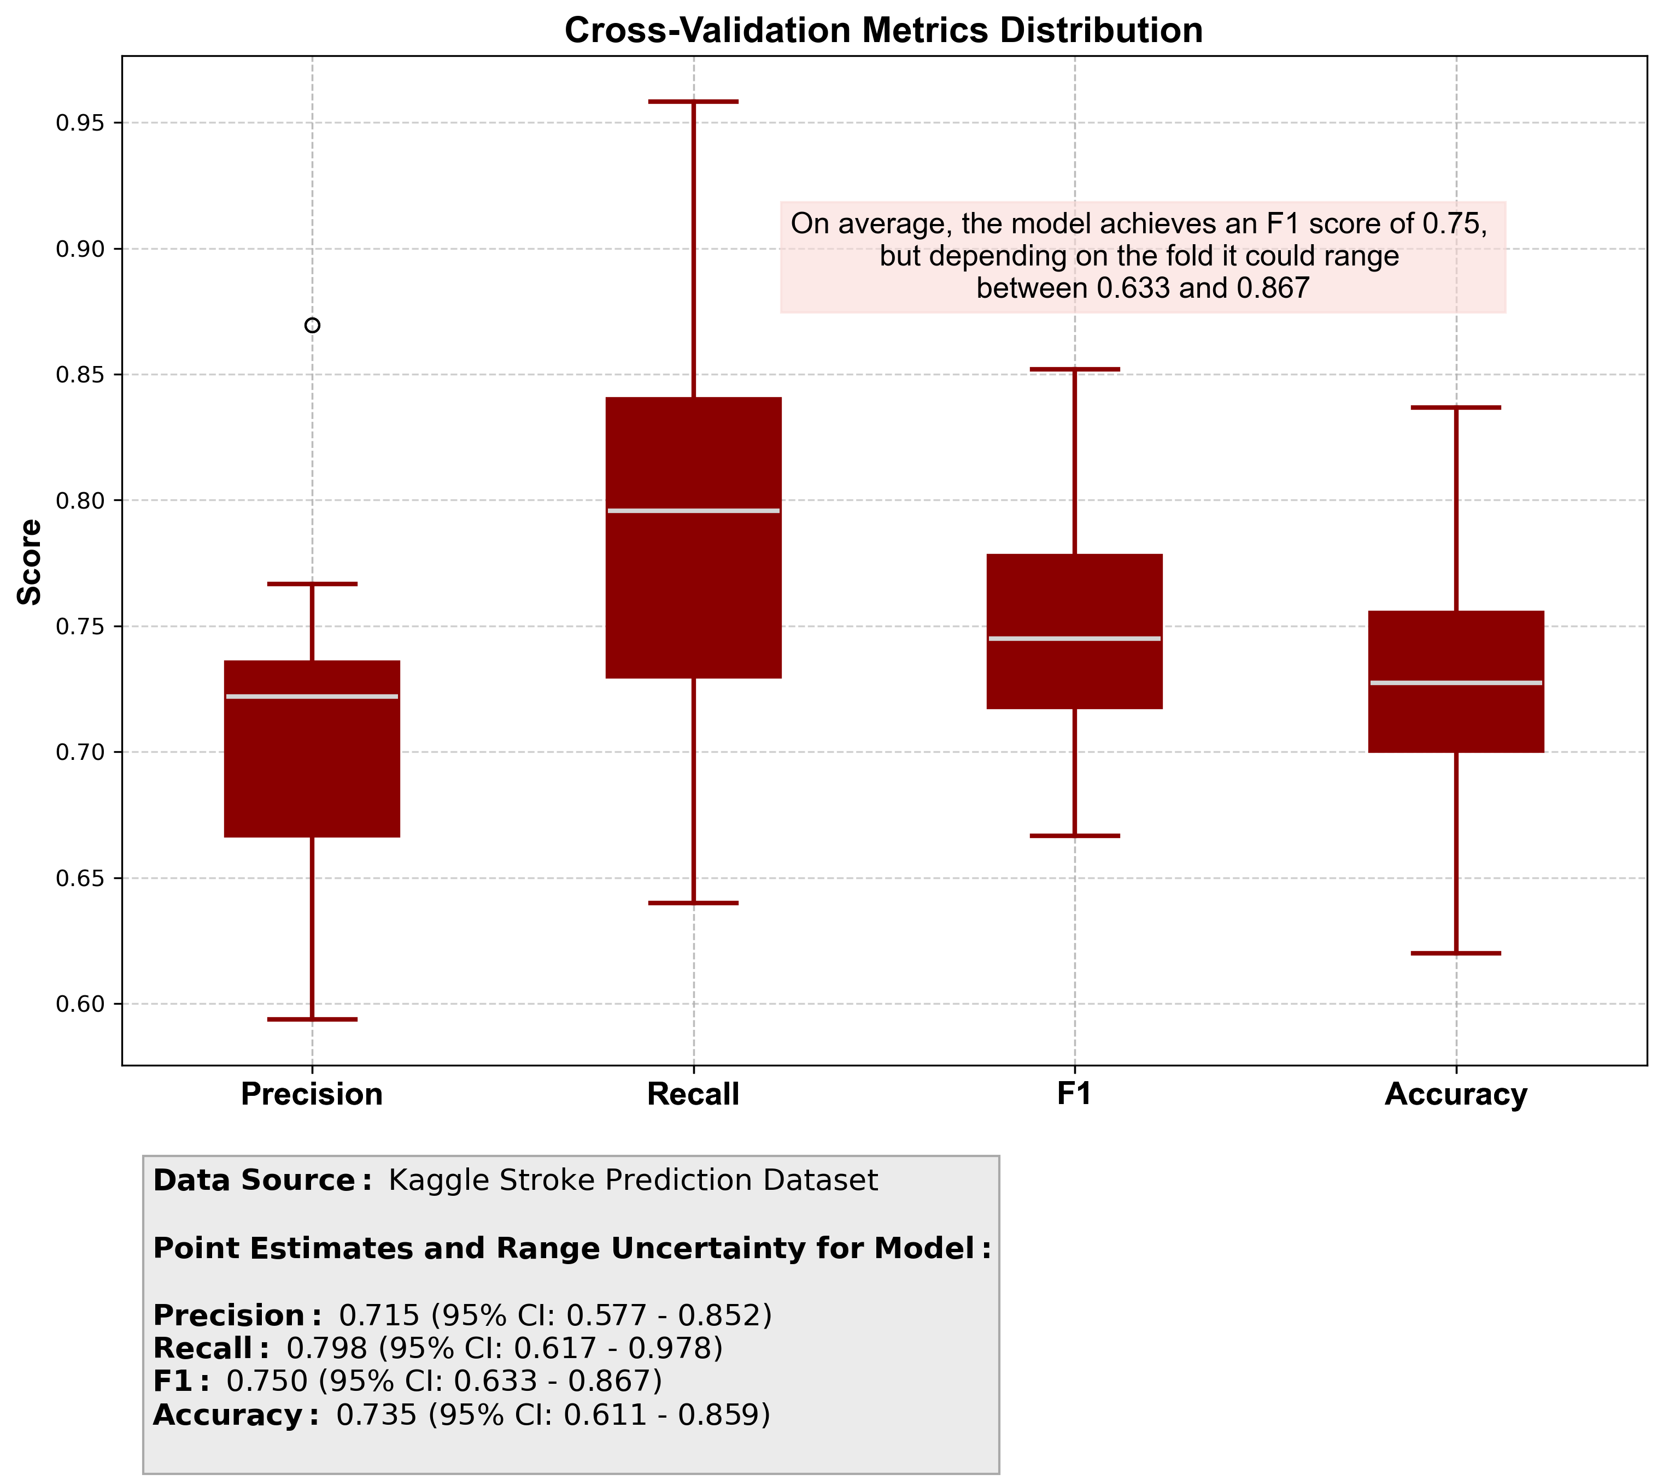
Model
Recall is consistently around 0.80, the model captures most true positives.
Precision is lower at 0.71, which suggests some false positives.
The F1 score is about 0.75, relatively balanced but skews towards recall. This is good in healthcare setting.
Accuracy is around 0.74, fairly good.
Overall, the model is strong at finding positives, but there is a trade‑off with precision.
In healthcare, being transparent about the range is critical and can build trust — stakeholders want to see variability.
Notes:
Lindsay

Slide 6
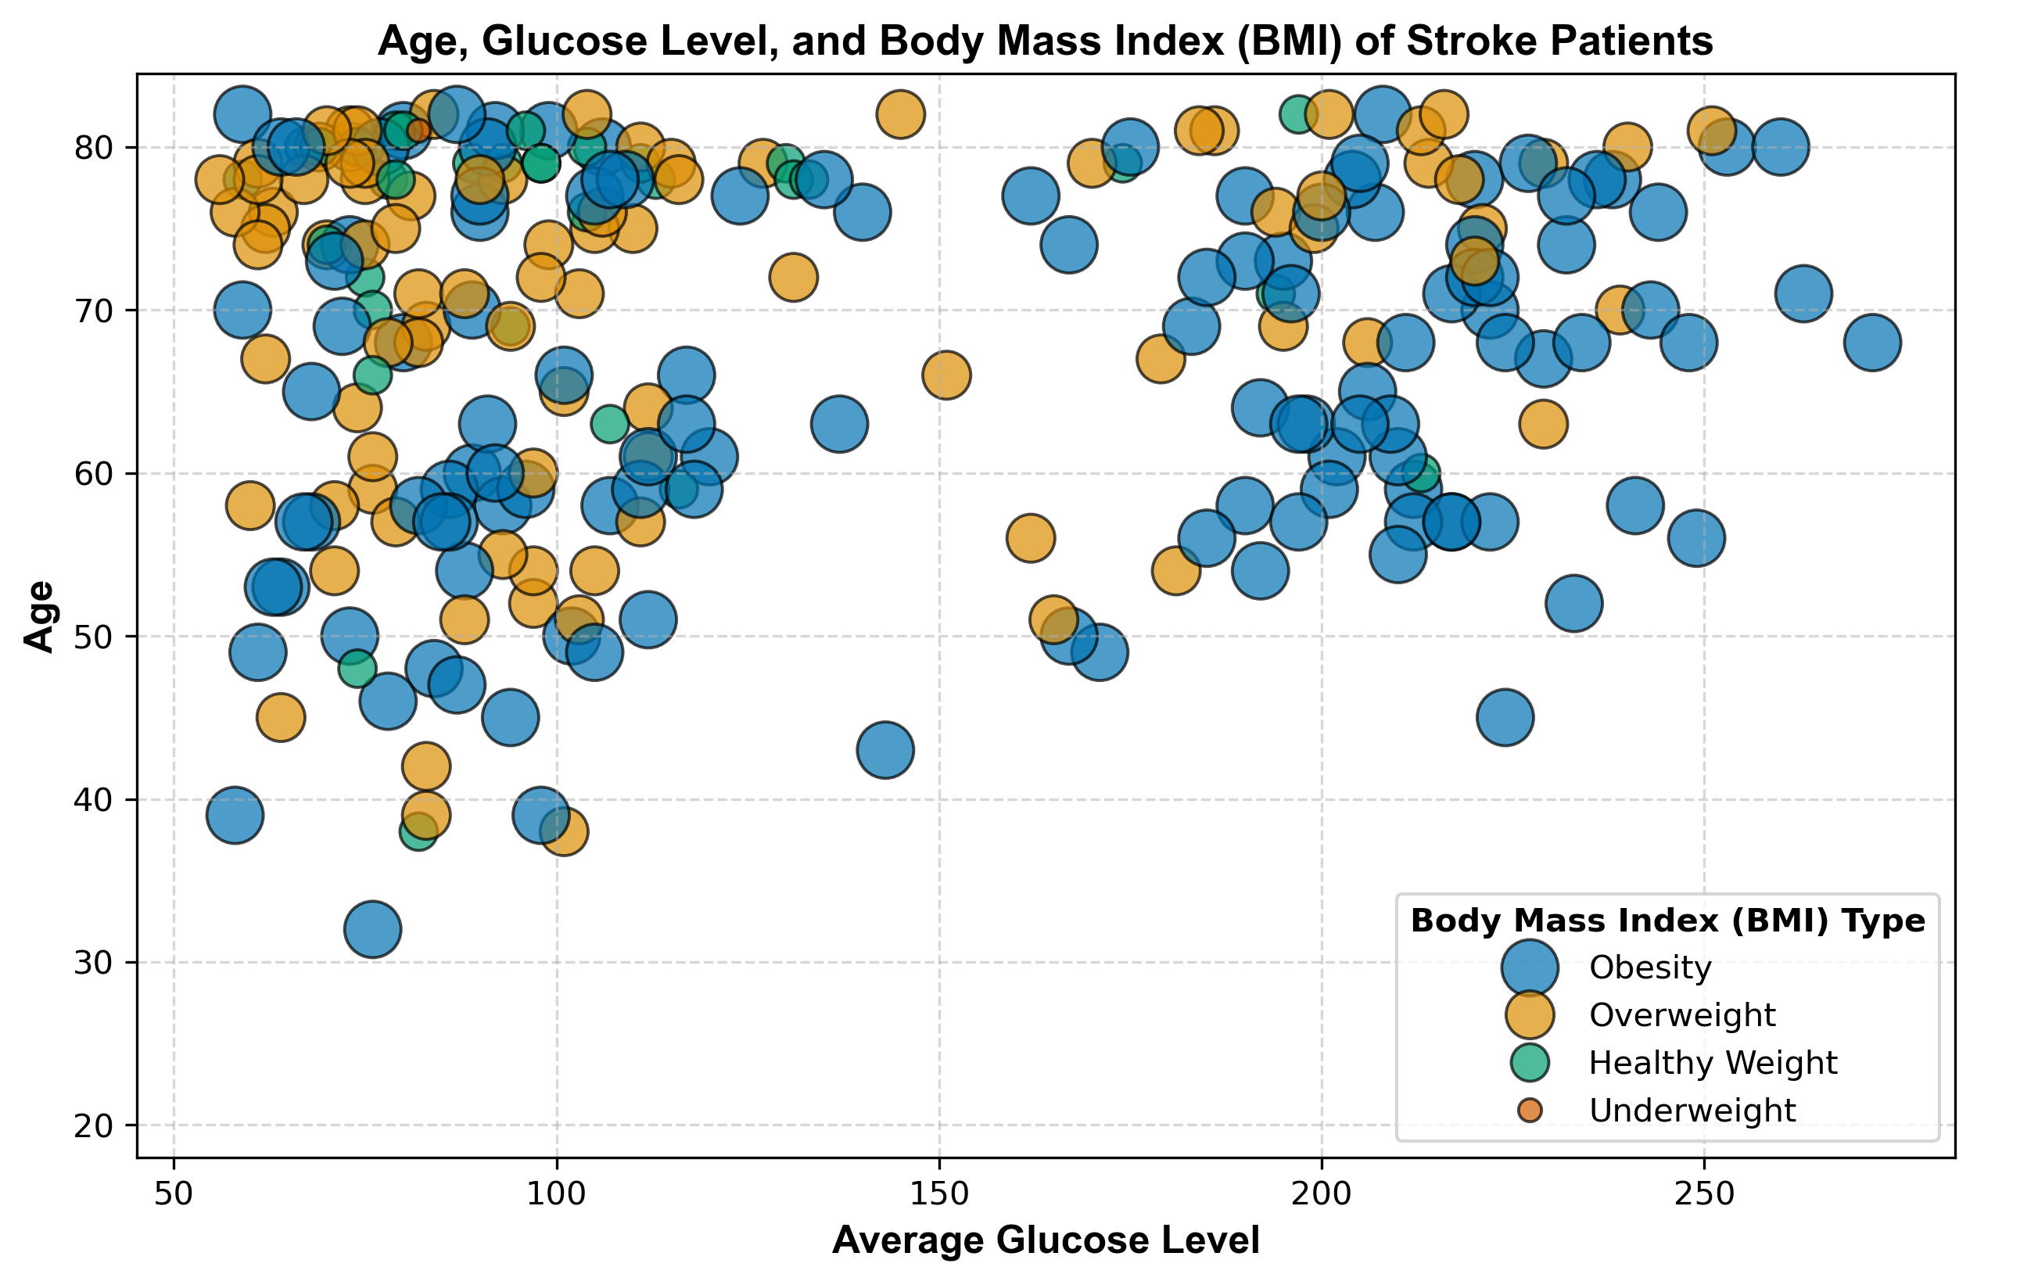
Team Specific Recomendations
The target population is:
  Individuals over 57 years old, with comorbidities as heard disease, hta, and pre-DM or DM . And Risk factors as overweight, formerly smoked or smokes.
  The analyst suggest healthy weight, healthy glucose average , and never smoke as protective factors.
Notes:
MariluzSlide 6.
The population most likely to have a stroke :
- Individuals over 57 years old
- comorbidities such as heart disease or hypertension
- glucose levels in the pre-diabetes or diabetes range
- risk factors such as overweight, former smoking, or current smoking
Protective factors:
Healthy weight
Healthy average glucose levels
Never smoked
OUR RECOMENDATION IS START preventive campaigns BEFORE 57 YEARS OLD WITH TARGET IN THIS VARIABLES TO HAVE A REAL IMPACT IN STROKE INCIDENCE.

Slide 7
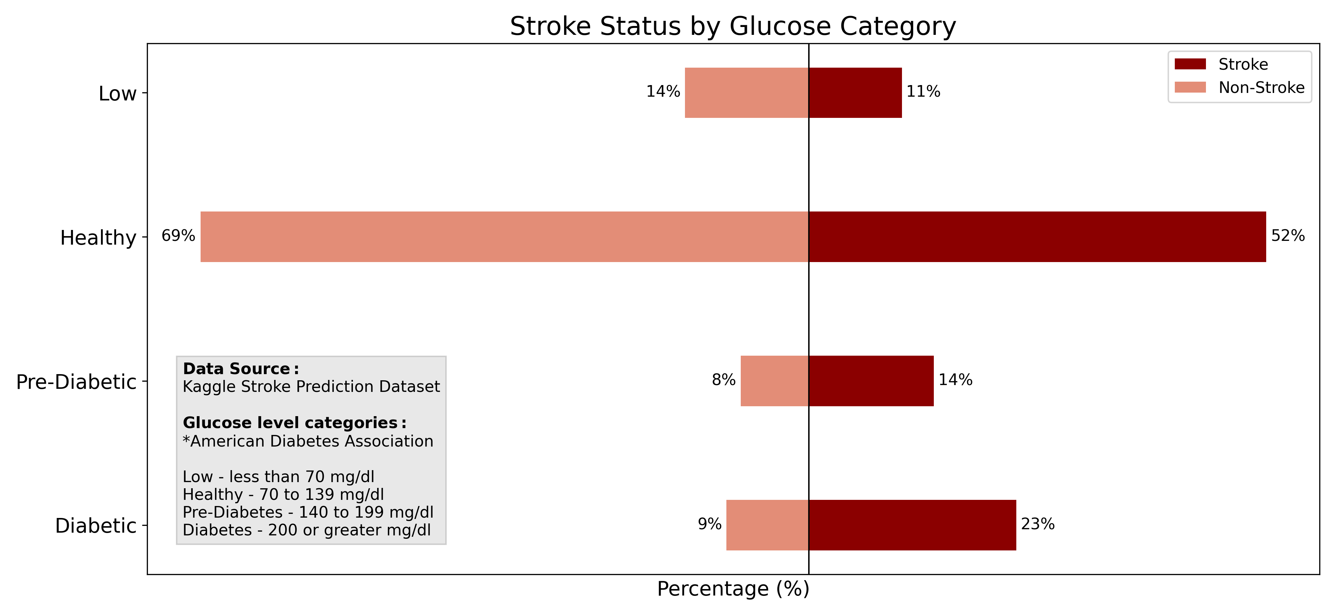
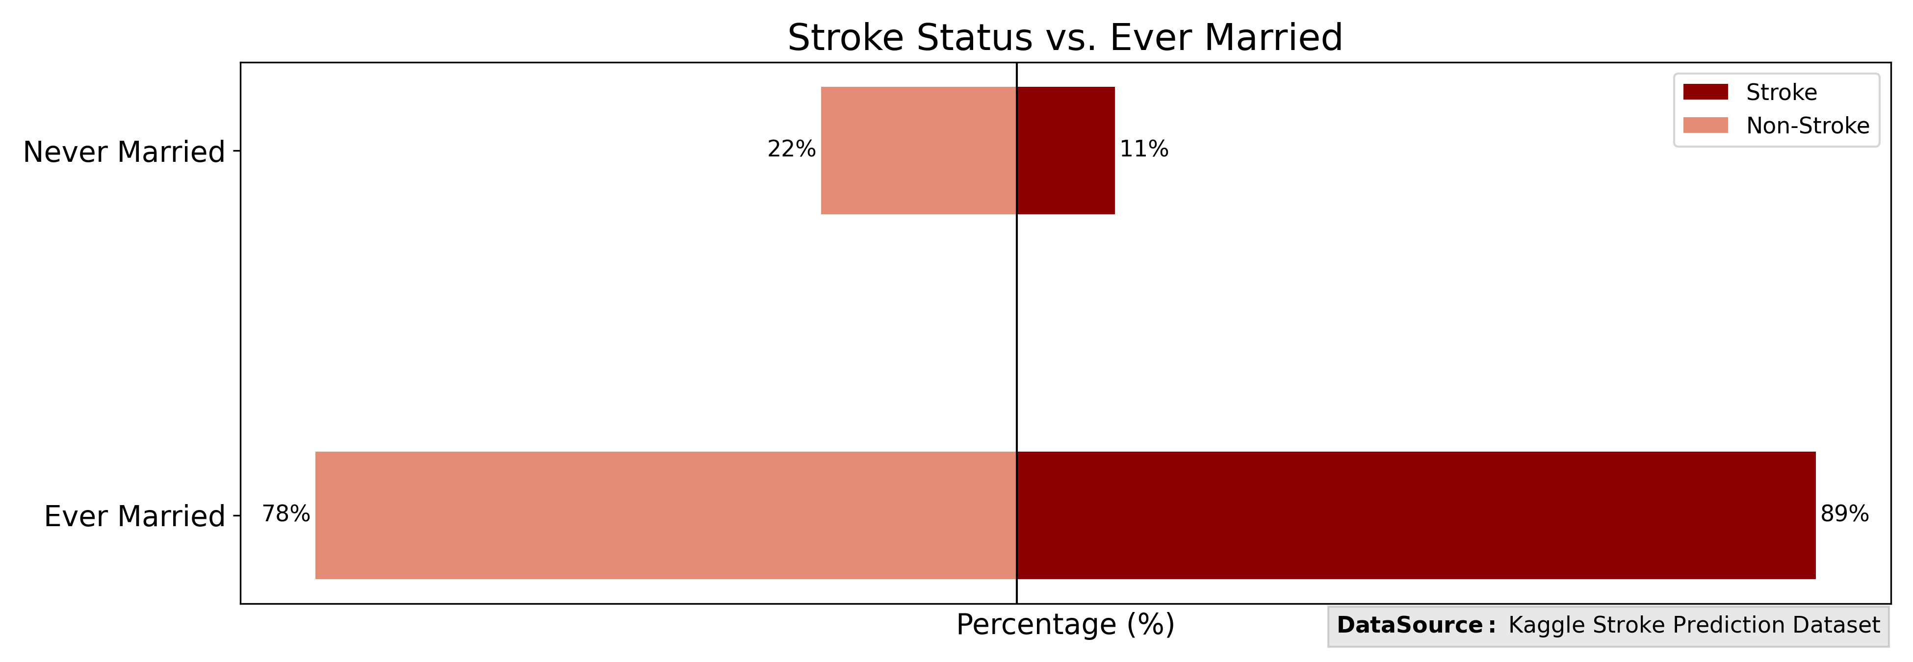
Key Data Insights:
Proper categorization of the dataset : The Key in analysis and model development.
Health data analysis: healthy individuals vs disease group
Correlation is not causation: Adjusted per age
Notes:
Mariluz
Slide 7.
Proper categorization of the dataset is essential.
Comparing groups properly matters. Both: healthy and sick individuals are needed for an adequate comparison and analyst.
Correlation is not causation.
AS WE SHOW IN Married status AFTER adjusted per age.

Slide 8
Conclusion & Next Steps
Feature selection was the key in our data-driven approach to make an accurate model.
Our next steps in refining our model would be:
  Apply a larger stroke population dataset combined with greater data collection context, and additional relevant features.
  Leverage SHAP analysis to understand what is driving predictions.
  Consider tracking performance across various demographic segmentations and audit model for potential biases.
  Validate the model on external clinical stroke datasets.
Notes:
Lindsay

Slide 9
Thank You
Feel free to write us your questions and
Lets conect by LikedIn!
Mariluz Lopez Zamora
www.linkedin.com/in/mlopezza
Joshua Okojie
www.linkedin.com/in/abayomiokojie/

